Slide 1
Basics of R
Notes:
Do we know the topic number for this?

Slide 2
Basics of R
Introduction to R
Data Structures in R
R Workspace
Packages in R
Reading,writing a dataset
First steps with a dataset

Slide 3
Introduction to R
Notes:
Do we know the topic number for this?

Slide 4
Introduction to R
What is R ?
First steps with R
How to use Rstudio ?
Online Resources for R

Slide 5

History of R
R is a successor of S Language
Originally designed by two University of Auckland Professors for their intro to statistics course.

Slide 6
Why R?
R is an open source language
R is an interpreted language; users typically access it through a command-line interpreter(similar to Unix)
Strong object-oriented programming facilities than most statistical computing languages.
Easily extensible through functions and extensions, and the R community is noted for its active contributions in terms of packages.
Provides a wide variety of statistical and graphical techniques

Slide 7
The Comprehensive R Archive Network(CRAN)
CRAN is the main repository for R core and its community built libraries.
It is the global community of R users and developers that is R’s primary strength
http://cran.r-project.org

Slide 8
RStudio
RStudio is a free and open source integrated development environment (IDE) for R
It has some nice features that make code development in R easy and fun, such as:
Code highlighting, making it easier to read
Automatic bracket matching
Code completion, so as to reduce the effort of typing the commands in full
Easy access to R Help
Easy exploration of variables and values
http://www.rstudio.com/products/rstudio/

Slide 9
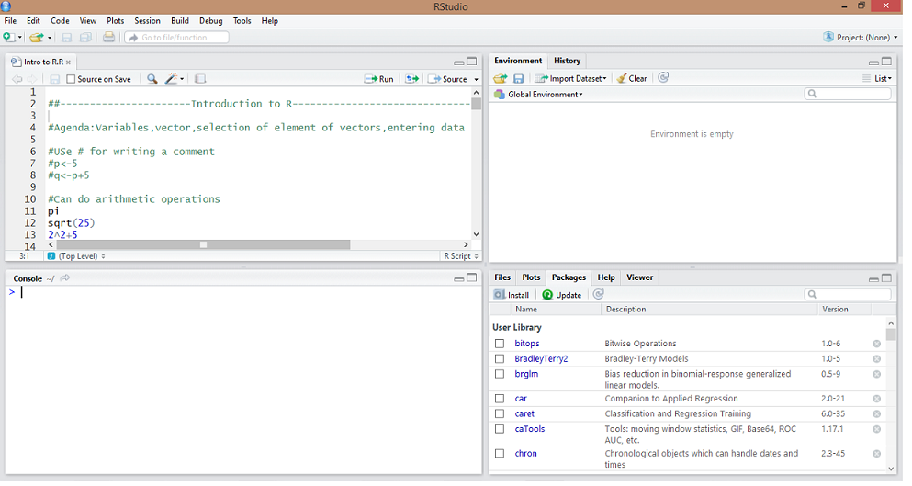
RStudio
Source Editor
Workspace/History
R Console
Files/Plots/Packages/Help

Slide 10
RStudio
Source : Contains a text editor. Users can save script file to disk, and perform other tasks on the script
Console :All the interactive work of R is performed here
Workspace : This is where the variables created in the session along with their values can be inspected.
History : The area where the user can see a history of the commands issued in R
Files: This is where the user can browse folders and files on a computer
Plots: This is where R displays the user’s plots
Packages :Shows list of installed packages
Help: This is where you can browse the built-in Help system of R.

Slide 11
Command Line
> New command
+ Awaiting completion of command

Slide 12
Packages
Packages are collections of R functions, data, and compiled code in a well-defined format. The directory where packages are stored is called the library
Currently, the CRAN package repository features 6126 available packages
CRAN Task Views allow you to browse packages by topic and provide tools to automatically install all packages for special areas of interest
http://cran.r-project.org/web/views/

Slide 13
Online Resources
R-bloggers : http://www.r-bloggers.com/
Revolution Analytics : http://blog.revolutionanalytics.com/
R Data Mining : http://rdatamining.wordpress.com/
Stack overflow : http://stackoverflow.com/

Slide 14
Books
R Cook Book – By Paul Teeter
R in a Nutshell – By Joseph Adler
An Introduction to Statistical Learning :With Applications in R – By Gareth James

Slide 15
Data Structures in R
Notes:
Do we know the topic number for this?

Slide 16
Data Structures in R
Vectors
Lists
Matrices
Dataframes

Slide 17
Data Structures in R
Vectors
Most Simplest structure in R
If data has only one dimension, like a set of digits, then vectors can be used to represent it.
Lists
It contain all kinds of other objects, including vectors, other lists or data frames
It can contain objects of different data types

Slide 18
Data Structures in R
Matrices
Used when data is a higher dimensional array
But contains only data of a single class Eg : only character or numeric
Data Frames
It is like a single table with rows and columns of data
The columns can be of different classes

Slide 19
Modes of Vectors
Character
Integer
Numeric
Complex
Factor
Date
>vec<-c(1,2,3,4,5)
> class(vec)
[1] "numeric"

Slide 20
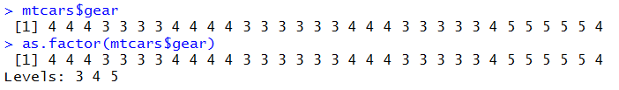
Factors
Factors are useful for calculations on categorical and qualitative variables,
e.g. gender, Marital Status, Credit Card status or group label.

Slide 21
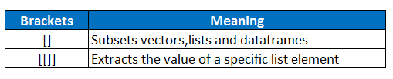
Subsetting Data Structures
All the data structures can be subsetted using brackets in R

Slide 22
R Workspace
Notes:
Do we know the topic number for this?

Slide 23
R Workspace
Setting Working Directory
Save Objects
Load Objects

Slide 24

R Workspace
Set your working directory
By default R maps to a certain current working directory
getwd() : Used to check current working directory
setwd() : For setting the current working directory as per choice
In Windows, use “\\” or “/” to delimit file paths

Slide 25
R Workspace
ls()
Lists all the objects currently in your workspace
Once you close your Rstudio session, all objects are lost
save.image()
Saves all objects in the workspace to the file
load()
Loads all objects in the file into the workspace
save.image(file="Intro_to_R_objects.RData")
load(file="Intro_to_R_objects.RData")

Slide 26
Packages
Notes:
Do we know the topic number for this?

Slide 27
What is a Package?
Packages are collections of R functions, data, and compiled code in a well-defined format.
The directory where packages are stored is called the library.
R comes with a standard set of packages. Others are available for download and installation.

Slide 28
Where to find Packages?
The CRAN website has a “Task Views” page that allows you to view packages according to subject area
http://cran.r-project.org/web/views/

Slide 29

Packages :Install & Load
Suppose you want to analyze the mtcars dataset using a randomForest model.
The base R installation does not have this capability natively.
Hence you need to install the Package that has the randomForest model algorithm

Slide 30
Packages :Install & Load
To check the list of existing packages (already installed)
library()
To check the list of packages currently loaded
search()

Slide 31
Reading and Writing Data
Notes:
Do we know the topic number for this?

Slide 32
Reading and Writing Data
First set your working directory
read.csv() : Read comma separated files
read.csv(“data.csv”)
read.table() : Read data based on the delimiter
read.table(“data.txt”,sep=“\t”,h=False)
write.csv() : writes the object as a csv file
write.csv(iris,“E:\\iris_data.csv”)

Slide 33
First Steps with a dataset
Notes:
Do we know the topic number for this?

Slide 34
First steps with a dataset
head : Displays the first few rows of the dataset
dim: Displays the number of rows and columns in a dataset
str : Displays the structure of the dataset
summary : To study the distribution of numeric values in the dataset
table : Gives the frequency distribution of the variable

Slide 35
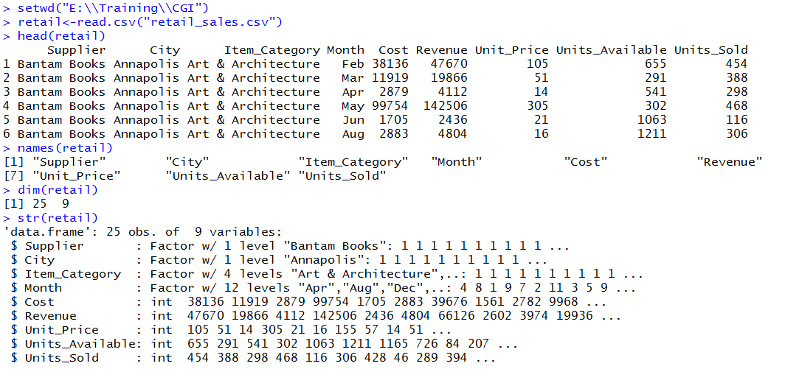
First steps with a dataset

